Slide 1
APUSH Review: The Civil War
Everything You Need to Know About The Civil War To Succeed In APUSH

Slide 2
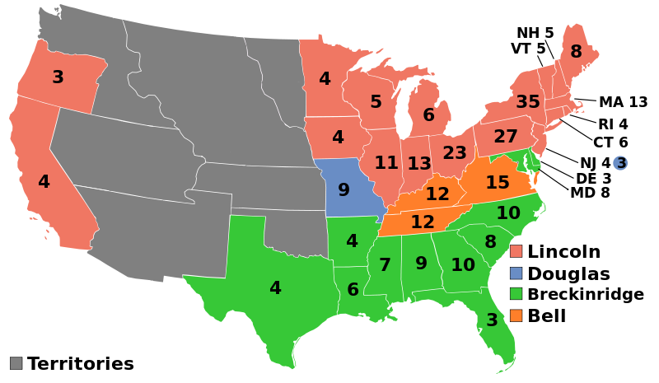
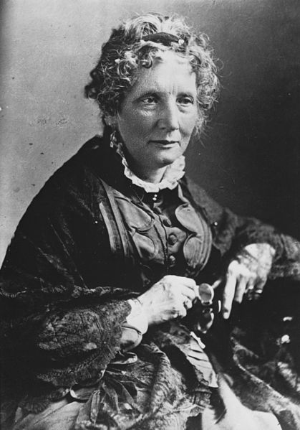
Causes of the War
Long-term:
Expansion of slavery
Popular Sovereignty
States’ Rights vs. Federal Power
Uncle Tom’s Cabin
Immediate:
Election of Abraham Lincoln in 1860
Lincoln wanted to PRESERVE the Union in the beginning
April 12, 1861:
Fort Sumter

Slide 3
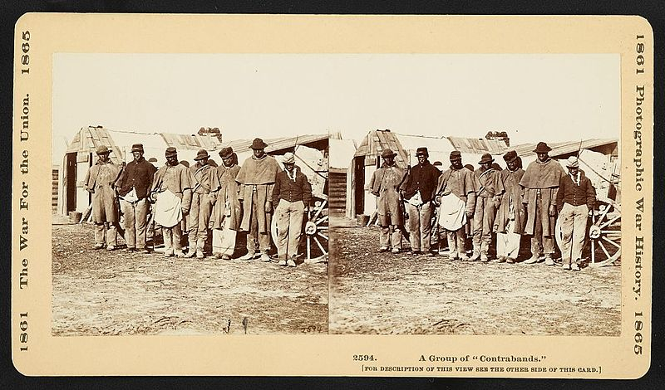
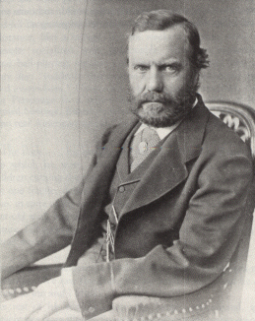
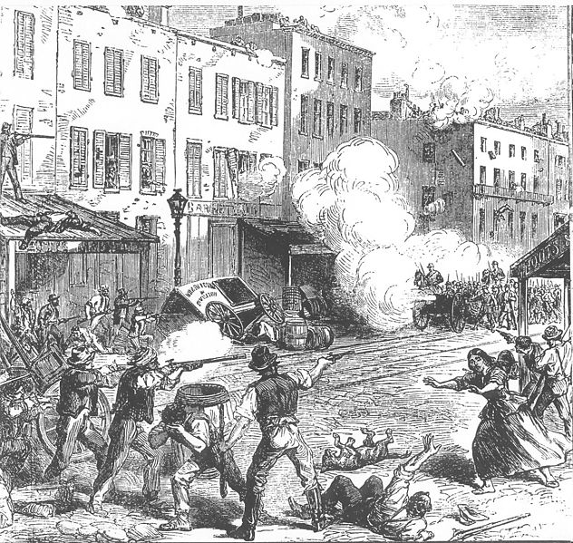
Key Terms To Know
Conscription:
Draft (forced enlistment)
Substitutes could be hired for people that were drafted
NYC Draft Riots (1863)
100s of people were killed
Contraband:
Escaped slaves that crossed over into the Union
Worked at camps and fought in the war
Copperheads:
Democrats that spoke out against the war

Slide 4
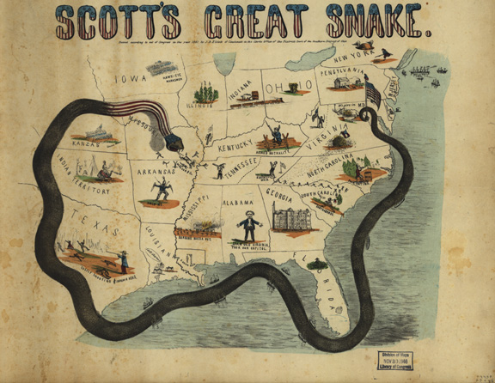
Key Strategies and Battles to Know
Union blockade of the South:
When Congress was NOT in session
Anaconda Plan
Antietam:
Bloodiest day of the war
South withdraws
Helped persuade Europe to NOT intervene on behalf of the South
Helps lead to the issuance of the Emancipation Proclamation

Slide 5
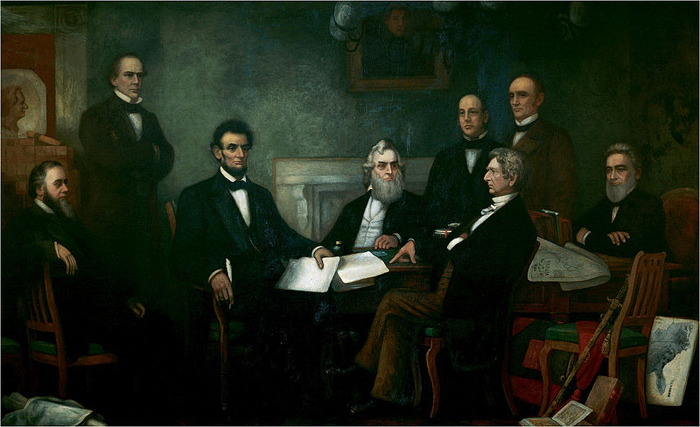
Emancipation Proclamation
Issued on January 1, 1863
Freed slaves only in areas of rebellion
Not in Border States
Not in areas under Union control
New Orleans
Helped change the goal(s) of the war
Originally, the war was fought to preserve the Union

Slide 6
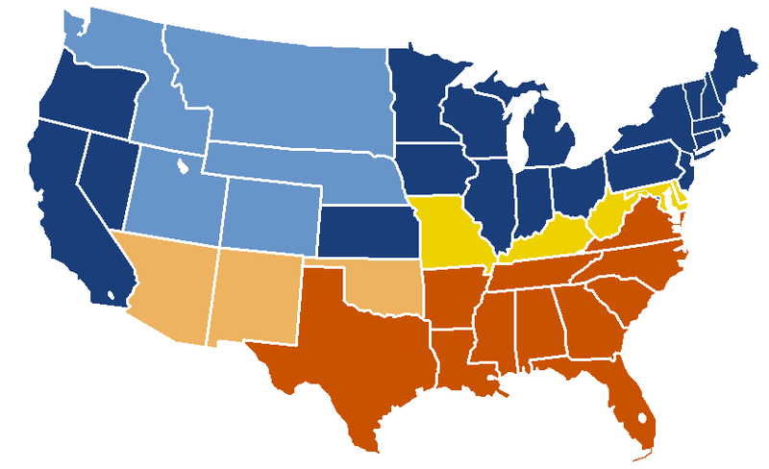
The Border States
What were border states?
Slave states that did NOT secede during the Civil War
Many fought on BEHALF of the Union.
Which states did this include?
Missouri, Kentucky, Maryland, Delaware, and West Virginia (later)

Slide 7
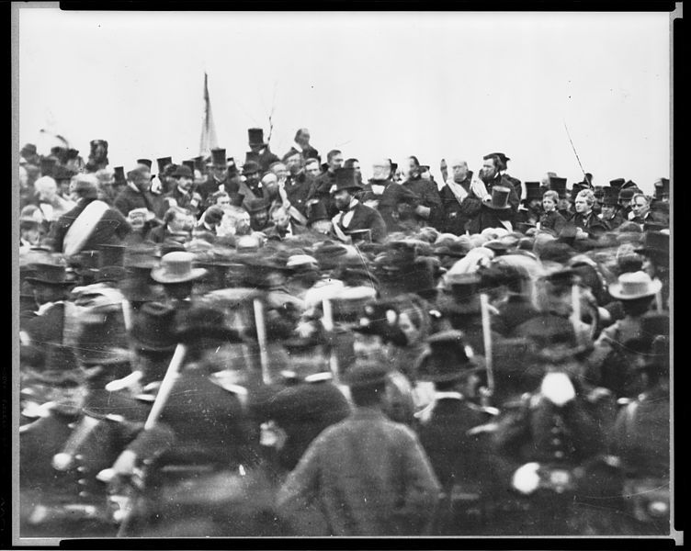
Gettysburg Address
Issued on November 19, 1863
Dedicated the battlefield as a cemetery
Referenced the Declaration of Independence
4 score and 7 years ago (87 years ago)
“we here highly resolve that these dead shall not have died in vain—that this nation, under God, shall have a new birth of freedom—and that government of the people, by the people, for the people, shall not perish from the earth.”

Slide 8
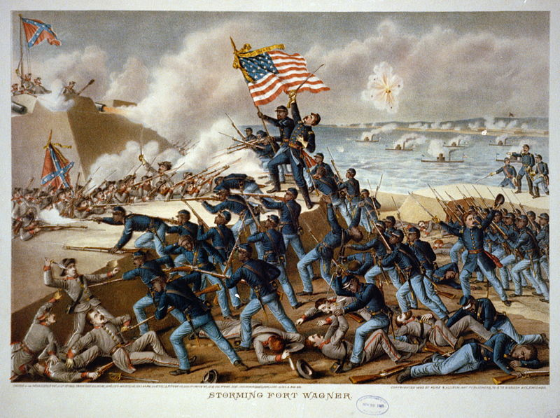
African Americans in the War
Beginning in 1862, African Americans could enlist in the war
54th Regiment
“Glory”
Fought in segregated units
Often did manual labor
African Americans were paid less than whites

Slide 9
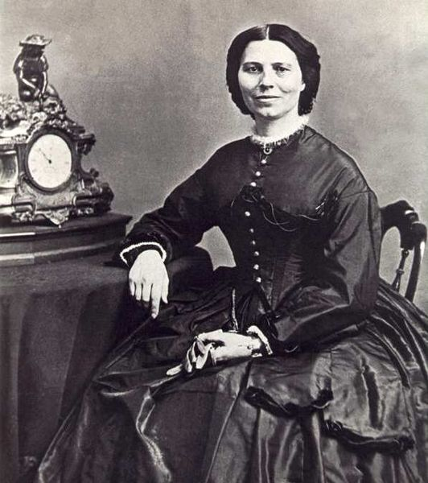
Women in the War
As men fought in the war, women’s employment opportunities increased
Teachers, factories, and nursing
National Woman’s Loyal League:
Elizabeth Cady Stanton and Susan B. Anthony
Hoped to abolish slavery and gain female suffrage
Clara Barton:
Helped distribute medical supplies during the war
Later founded the Red Cross

Slide 10
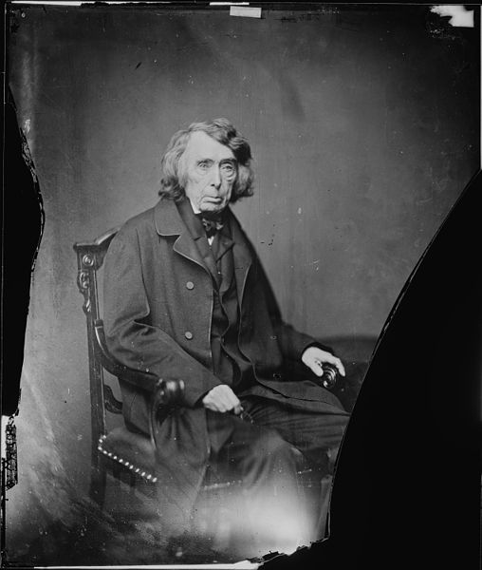
Personal Liberties in the War
Habeas Corpus:
Cannot be held in jail without having charges brought against you
Lincoln suspended Habeas Corpus
Only Congress can suspend
Ex Parte Merriman (1861):
Court ruled President could not suspend Habeas Corpus, Lincoln ignored the decision
Newspapers in Maryland were shut down that were critical of Lincoln

Slide 11
The End and Effects of the War
April 9, 1865, Lee surrenders
April 14, 1865, Lincoln was shot
Reconstruction
Presidential v. Congressional
Amendments: 13th, 14th, and 15th

Slide 12
Thanks for watching!
Subscribe to my channel
Help spread the word
Questions? Comments? Ideas for videos?
Leave in comments
Subscribe
Down here!

